Slide 1
Chapter 1 Introduction to Software Process Models
SOFTWARE ENGINEERING

Slide 2
Contents
Waterfall Model
Incremental Model
Iterative Model
RAD Model
Prototyping
Spiral Model
Concurrent Model

Slide 3
Software Development Life Cycle
SDLC consists of 5 phases:
Planning
Analysis
Design,
Implementation
Support.
Each phase has some activities associated with it, and each activity may have some tasks associated with it.

Slide 4
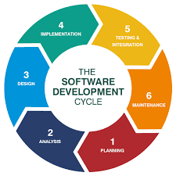
SDLC Software Development Life Cycle

Slide 5
1. Planning Phase
Following are the activities of the Planning Phase:
i] Define the Problem
- Meeting the Users
- Determine scope of Problem
- Define System capabilities
ii] Confirm Project Feasibility :
- Identify intangible costs & benefits
- Estimate tangible, developmental, & operational costs
- Calculate NPV, ROI, Payback
- Consider technical, cultural, schedule feasibility of the Project

Slide 6
iii] Plan Project Schedule
the activities and tasks of each phase.
iv] Staff the Project
(Provide required staff, such as the Analysts, the Programmers, the End-Users, etc.)
v] Launch the Project
(Begin actual work on the Project)

Slide 7
2. Analysis Phase :
Following are the activities of the Analysis Phase:
i] Gather information
- Meet the User
- Obtain information by: observing business procedures, asking questions to user, studying existing documents, reviewing existing systems, etc.
ii] Define System Requirements
(Review & analyze obtained information and structure it to understand requirements of new system, using graphical tools.)
iii] Build Prototype for Discovery of Requirements
(Build pieces of System for Users to review)

Slide 8
iv] Prioritize Requirements
(Arrange requirements in order of importance)
v] Generate & Evaluate alternatives
(Research alternative solutions while building system requirements.)
vi] Review recommendations with Management (Discuss all possible alternatives with Management and finalize best alternative)

Slide 9
3 Design Phase :
i] Design & Integrate Network
(Understand Network Specifications of Organization: Computer equipment, Operating Systems, Platforms)
ii] Design Application Architecture
- Design model diagrams
- Design the required computer program modules
iii] Design User Interfaces
(Design the forms, reports, user screens, and decide on the sequence of interaction.)

Slide 10
iv] Design System Interface
(Understand how the new system will interact with the existing systems of the organization)
v] Design & Integrate Database
(Prepare a database scheme and implement it into the system) .
vi] Build Prototype for Design Details
(Check workability of the proposed design using a prototype.)
vii] Design & Integrate System Controls
security and database integration

Slide 11
4 Implementation Phase :
Activities:
i] Construct Software Components
Write code for the design
ii] Verify & Test Software
(Check the functionality of the software components.)
iii] Build Prototype for Tuning

Slide 12
iv] Convert Data
Incorporate data from existing system into new system
v] Train & Document
Train users to use the new system and Document all necessary things.
vi] Install Software
(check for database access)

Slide 13
5 Support Phase :
i] Provide support to End-Users
Helpdesk facility /training programs
ii] Maintain & Enhance new System
provide upgrades

Slide 14
Factors in choosing a software process model
Project requirements
Project size
Project complexity
Customer involvement
Familiarity with technology
Project resources

Slide 15
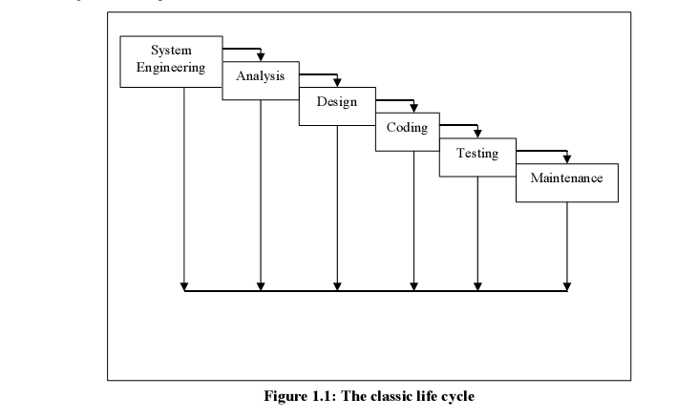
Waterfall Model

Slide 16
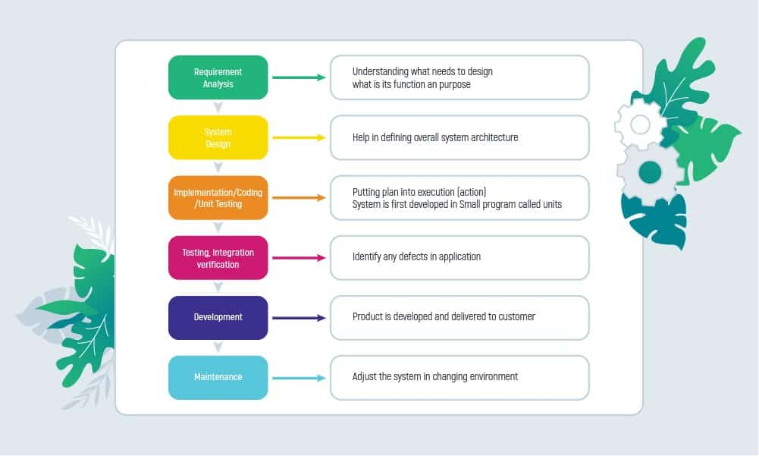

Slide 17
Waterfall Model
Also known as the linear sequential model / classic Life cycle Model.
A systematic and sequential approach to software development that
begins at the system level and
progresses through analysis, design, coding testing and maintenance.

Slide 18
System Engineering and Analysis :
Work on software development begins by establishing the requirements for all elements of the system.
Involves gathering of requirements at the system level.
The analyst must understand the information domain of the software as well as required function, performance and interfacing.
Requirements are documented and reviewed with the client (SRS).

Slide 19
Design:
Software design is a multi-step process that focuses on
Data structures
Software architecture
Procedural detail
Interface characterization.
The design process translates requirements into a representation of the software that can be assessed for quality before coding begins.
The design phase is also documented and becomes a part of the software configuration.

Slide 20
Coding:
The design must be translated into a machine readable form.
Coding performs this task.
Detailed the design, easier is the coding.

Slide 21
Testing :
Once code is generated, it has to be tested.
Focuses on the logic as well as the function of the program
to ensure that the code is error free
Output matches the SRS

Slide 22
Maintenance :
Changes may occur on
account of errors encountered,
To adapt to changes in the external environment
To enhance the functionality and / or performance.
It Reapplies each of the preceding life cycles to the existing program.

Slide 23
Some of the disadvantages are :-
1. Real projects rarely follow the sequential flow that the model proposes. Iteration always occurs and creates problems in the application of the model.
2. It is difficult for the client to state all requirements explicitly..
3. A working version of the program is not available earlier.
4. In this model we freeze software and hardware technologies.
[ Not advisable especially in long-term projects. ]
5. Going back a phase or two can be a costly affair.
6. Customer must have patience.

Slide 24
Advantages
1. This model provides a template for SDLC
2. The steps of this model are the generic steps that are applicable to all software engineering models.
3. Waterfall model is simple to implement and also the amount of resources required for it are minimal.

Slide 25
Advantages
4. Preferred in
projects where quality is more important
as compared to schedule or cost.
5. visible outputs after each phase to make project management easy.

Slide 26
What factors contribute to choosing the Waterfall approach ?
Short-term projects
Clear, fixed, and well-documented requirements
Technology that is understood
Stable product definition
Low Product Owner Involvement
Strictly-set timeline
Fixed budget that cannot be changed

Slide 27
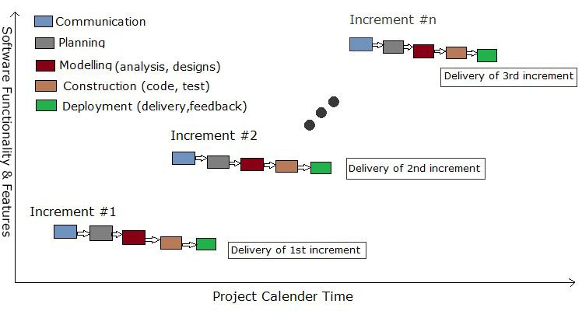
Incremental model

Slide 28
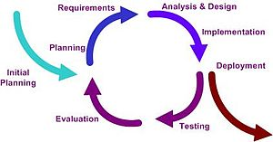
Fig: Iterative model

Slide 29
Iterative approach
Heart of a cyclic software development process
It starts with an initial planning and ends with deployment with the cyclic interactions in between.
Iterative and incremental development are essential parts of the Extreme Programming and generally the various agile software development frameworks.
Follows the plan-do-check-act cycle

Slide 30
Tasks involved
Communication: helps to understand the objective.
Planning: required as many people (software teams) work on the same project but different function at same time.
Modeling: involves business modeling, data modeling, and process modeling.
Construction: this involves the reuse software components and automatic code.
Deployment: integration of all the increments.

Slide 31
The basic idea is to develop a system through repeated cycles (iterative) and in smaller portions at a time (incremental)
allowing software developers to take advantage of what was learned during development of earlier parts or versions of the system.
At each iteration:
design modifications are made
and new functional capabilities are added.

Slide 32
The iteration involves
Implementation of a task from the project control list (PCL) and
Aanalysis of the current version of the system.
The goal for the design and implementation of any iteration is to be
simple,
straightforward,
modular

Slide 33
Advantages of Iterative model:
Parallel development can be planned.
Progress can be measured.
It supports changing requirements.
Better suited for large and mission-critical projects
Building and Improving the product step by step.
We can get the reliable user feedback.
Each iteration is an easily managed milestone.

Slide 34
Disadvantages of Iterative model:
Each phase of an iteration is rigid with no overlaps
Not all requirements are gathered up front for the entire lifecycle
More resources may be required.
More management attention is required.
End of project may not be known which is a risk.
Not suitable for smaller projects.

Slide 35
Iterative Model Application
Requirements of the complete system are clearly defined and understood.
When the project is big.
Major requirements must be defined; however, some details can evolve with time.
There are some high risk features and goals which may change in the future.

Slide 36
Difference between Incremental and Iterative Model
Incremental development is a development approach that slices the product into fully working slices that are called increments. Each new increment builds on top of the existing released functionality.
Iterative development is when teams gradually build up the features and functions but don’t wait until each of these is complete before releasing. They release a basic version of each feature and the add to that feature in subsequent iterative releases, usually based on feedback from the basic version released.

Slide 37
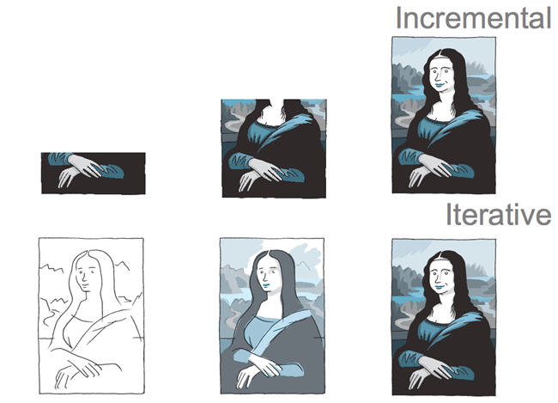

Slide 38







Example: Ecommerce website
CONSIDER A TEAM BUILDING AN ECOMMERCE WEBSITE . THE FINAL PRODUCT MUST HAVE FOLLOWING FUNCTIONALITIES : -
SEARCH
PRODUCT INFORMATION
A SHOPPING BASKET
CHECKOUT
FAVORITES
CUSTOMER REVIEWS.

Slide 39
Example: Ecommerce website Incremental Approach
Consider a team building an ecommerce website using incremental development. The final target product has search, product information, a shopping basket, checkout, favorites, and customer reviews.
For the first released increment, the team builds the basic functionality to buy a product. It includes search, product information, adding products to a shopping basket and checkout. This first slice would only be released once it’s complete.
The second released increment builds on that basic functionality, and would add another capability such as favourites. The would be released when the favorites functionality is complete.
The third released increment adds customer reviews once that is complete, and so on.

Slide 40
Example: Ecommerce website Iterative Approach
Assume a team building the same ecommerce website using an iterative process.
The first release has a really stripped back version of all the required functionality; namely search, product information, a shopping basket, checkout, favorites, and customer reviews.
For the second iterative release, the team would improve some of the existing basic functionality, taking into account feedback from stakeholders or customer, or other inputs such as analytics.
On every subsequent iterative release, new ideas and requirements are added or low value/usage areas may be removed.

Slide 41
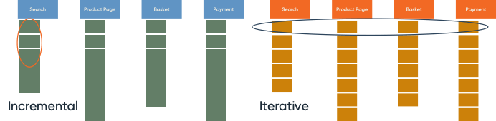
Example: Ecommerce website Incremental and Iterative

Slide 42
Where is the Iterative Model applicable in software development?
System requirements are clearly defined and fully understood
Additional requirements can occur with time
When the team learns new technology and works on the project simultaneously
Specific resources are to be used only when they are required for specific iterations according to the contract
When the business goals might change in the future due to high-risk features

Slide 43
Problem Statement
Centric Consulting Pvt. Ltd is a well-known software company , they have become famous in a very short span of time due to their software development approach .
Customers come to them with a requirement for a software that would interface with their software , one of which had over 35,000 employees, for procurement, invoicing, and payment.
The key features of the development cycle are as follows:-
fast-paced development projects, which are completed within in 60 to 90 days.
With every module of the software, they perform Business modelling ,Data modelling , Process modelling ,the application is generated and then tested .
The Application generation makes use of reusability concepts and high automated tools .

Slide 44
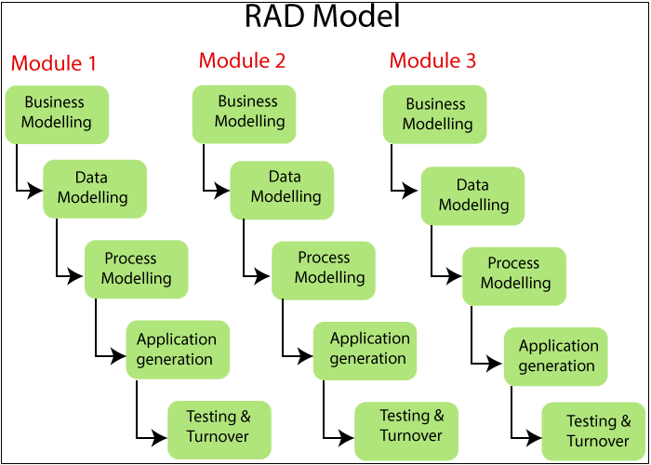
RAD

Slide 45
Rapid Application Development (RAD) Model
Emphasizes an extremely short development cycle.
The RAD model is a high-speed adaptation of the linear sequential model
Rapid development is achieved by using component-based construction.
If requirements are well understood and project scope is constrained, the RAD model
Enables a development team to create a fully functional system within 60-90 days.

Slide 46
Used primarily for information system applications, the RAD approach encompasses the following phases :
Business modeling : The information flow among business functions is modeled so as to understand the following:
i) The information that drives the business process
ii) The information generated.
iii) The source and destination of the information generated.
iv) The processes that affect this information.

Slide 47
RAD
Data modeling :
The information flow defined, is refined into a set of Data objects that are needed to support the business.
The attributes of each object are identified and the relationships between these objects are defined.

Slide 48
RAD
Process modeling:
The data objects defined are transformed to achieve the information flow necessary to implement a business function.
Processing descriptions are created for data manipulation.

Slide 49
RAD
Application generation :
create reusable components.
The actual system is built and
coding is done by using automation tools to convert process and data models into actual prototypes.

Slide 50
RAD
Testing and turnover:
Since RAD emphasizes reuse, most of the components have already been tested.
This reduces overall testing time.
However, new components must be tested and all interfaces must be fully exercised.
Each major function can be addressed by a separate RAD team and then integrated to form a whole.

Slide 51
Advantages :
Quick initial reviews are possible
Flexible and adaptable to changes.
Overall reduction in project risk
Modularized approach to development
Creation and use of reusable components
Drastic reduction in development/testing time

Slide 52
Disadvantages :
Needs huge no. of resources for large projects.
Not all types of applications are appropriate for RAD. (specially if system can’t be modularized)
Not appropriate when the technical risks are high.

Slide 53
When to use RAD Methodology?
When a system needs to be produced in a short span of time (2-3 months)
When the requirements are known
When the user will be involved all through the life cycle
When technical risk is less
When there is a necessity to create a system that can be modularized in 2-3 months of time
When a budget is high enough to afford designers for modeling along with the cost of automated tools for code generation

Slide 54
Prototyping model
Prototyping is the creation of software application prototypes that show the visual representation of the minimal features of the incomplete product. This enables understanding customer requirements early in the development stage and getting valuable feedback. The model includes:
Identification of basic requirements
Initial prototype development
Prototype review
Prototype revision and enhancement

Slide 55
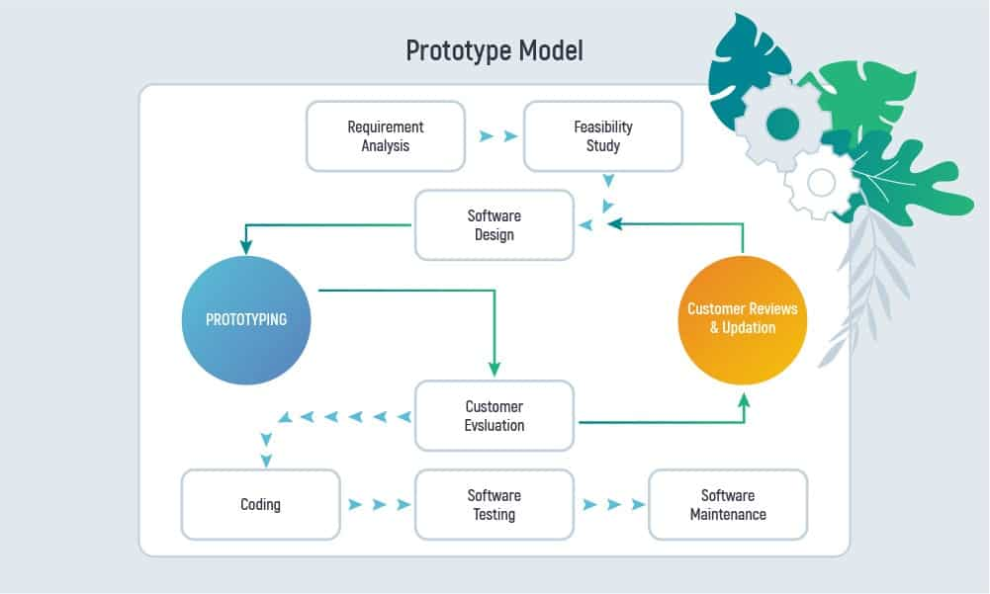

Slide 56
Types of Prototyping
Rapid Prototyping – on understanding requirements the system is built with a clearer understanding of user needs
Evolutionary Prototyping – development of functional prototypes with limited functionality based on the understood requirements and adding the other requirements in the process
Incremental Prototyping – building numerous functional prototypes that form a system and putting them together
Extreme Prototyping – it is a web development domain with three phases: basic prototype in the HTML; prototype service layer; implementation and integration in the final prototype

Slide 57
Where and when is the Prototyping Model applicable?
Prototyping is applicable to online software system development where there is a high level of user interaction. For example,
Systems that require users to fill out forms
Software that requires lots of data processing

Slide 58
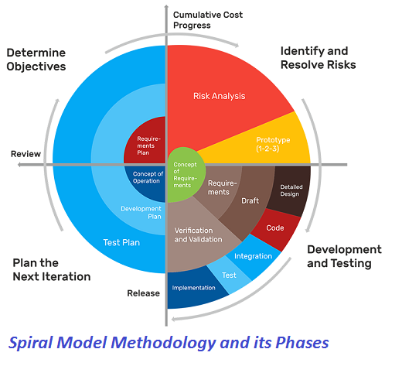

Slide 59
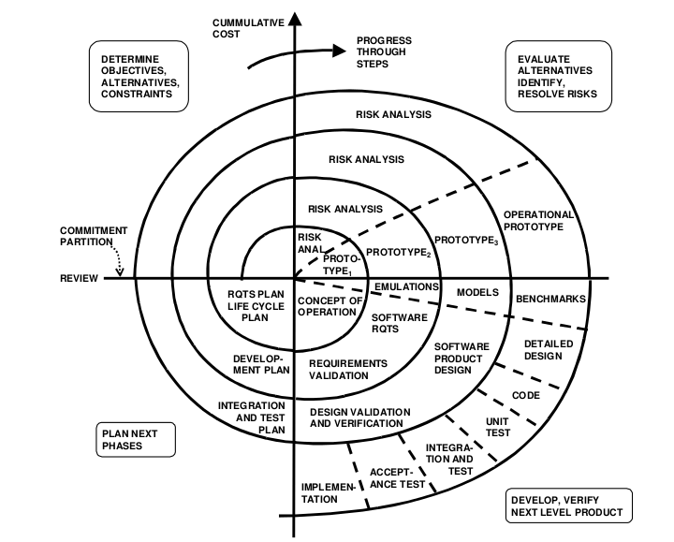

Slide 60
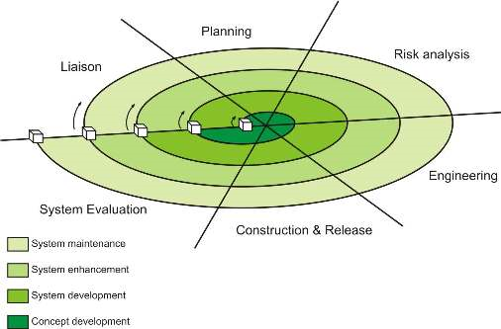
Spiral model

Slide 61
Spiral model
Proposed by Barry Bohem in 1988
It incorporates the prototype driven approach along with the classic software life cycle.
Is also takes into account the risk assessment
Unlike all other models which view designing as a linear process, this model views it as a spiral process.

Slide 62
Spiral model
At every spiral there is a risk assessment phase to evaluate the designing efforts
At the end of each spiral there is a review phase

Slide 63
Spiral model
Six major activities of each designing spirals are represented by six major tasks:
1. Customer Communication 2. Planning 3. Risk Analysis 4. Software Designing Engineering 5. Construction and Release 6. Customer Evolution

Slide 64
Spiral model
Advantages
It facilities high amount of risk analysis.
More suitable for large software projects.
Users see the system early.
Allows for extensive use of prototypes
Changing requirements can be accommodated.

Slide 65
Spiral model
Disadvantages
Risk analysis requires high expertise.
2. It is costly model to use
3. Not suitable for smaller projects.
4. Spiral may go indefinitely.
5. End of project may not be known early.
6. This model is relatively new.

Slide 66
When is it best to use the Spiral Model?
The Spiral Model is applied when there is a need to “learn with the product’s maturity” and:
There’s a budget limit and you need to foresee risks
You have a medium or high-risk project to carry out
There is a long-term project, and changes might occur
The requirements are vague to the customer
Requirements need more clarity due to their complexity
The primary product has to be released in several stages to get valuable customer feedback
You expect major changes to the product during the SDLC

Slide 67
Concurrent Development Model
Also called concurrent engineering.
Development and QA/Testing are performed concurrently
Similar to the Synchronize and Stabilize model used by Microsoft
Multiple baselines are included as part of the process
SRS evolves over the course of the project
Ends with a formal validation phase with defined criteria for starting and stopping

Slide 68
Concurrent Development Model
A series of major technical activities, tasks, and their associated states.
The activity-analysis may be in any one of the states noted at any given time.
Design or customer communication can be represented in an analogous manner.
All activities exist concurrently but reside in different states.
Ex: early in a project the customer communication activity has completed its first iteration and exists in the awaiting changes state.

Slide 69
Concurrent development model
The analysis activity (which existed in the none state while initial customer communication was completed) now makes a transition into the under development state.
Concurrent engineering is a work methodology based on the parallelization of tasks (i.e. performing tasks concurrently).

Slide 70
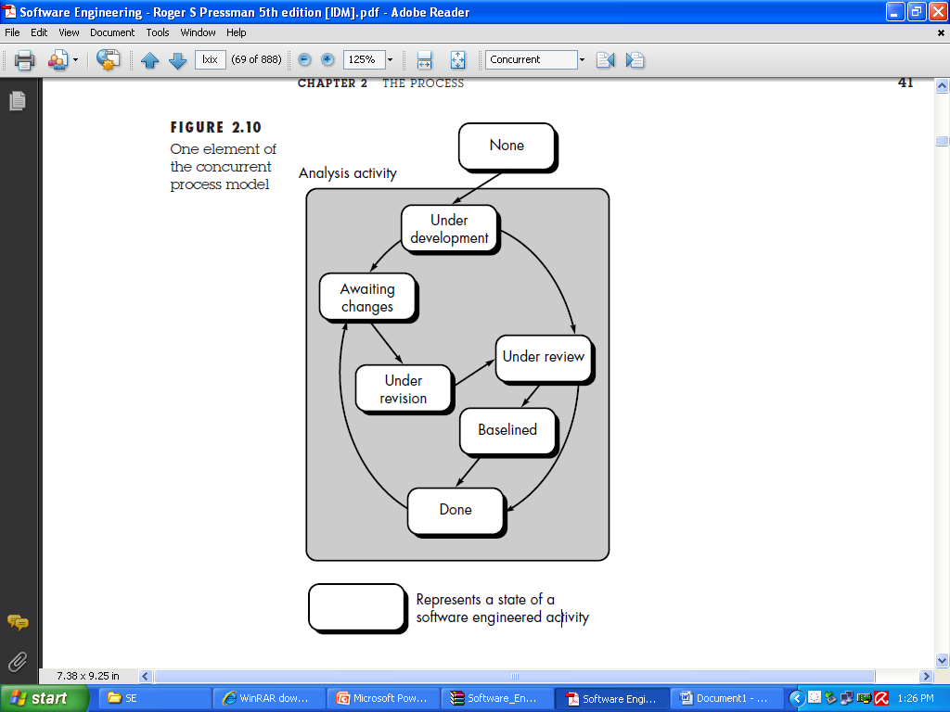

Slide 71
Advantages of the Concurrent Development Model
It’s flexible – the number incremental releases can be determined by the project team
Immediate feedback from testing
New features can be added late in the project
No surprises during formal validation because testing has been continuous

Slide 72
Disadvantages of the Concurrent Development Model
The SRS must be continually updated to reflect changes
It requires discipline to avoid adding too many new features too late in the project

Slide 73
Conclusion
Synthesizes the existing literature.
Each method is described in terms of process, roles, responsibilities, practices, adoption and experiences.
It is successful because it emphasis on high level customer satisfaction

